Slide 1
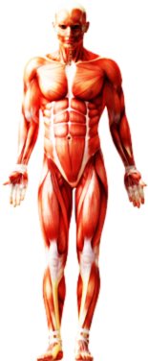
Towards Inertial Musculoskeletal Analysis: Effects of Sensor-to-Segment Calibration on Predicted Ground Reaction Forces
Medicine
wearHEALTH
Intelligent
Prostheses
Rehabilitation
Robotics
HCI
Sports
Sciences
Industrial Ergonomics
Master‘s Thesis – Felix Laufer
wearHEALTH, TU Kaiserslautern

Slide 2
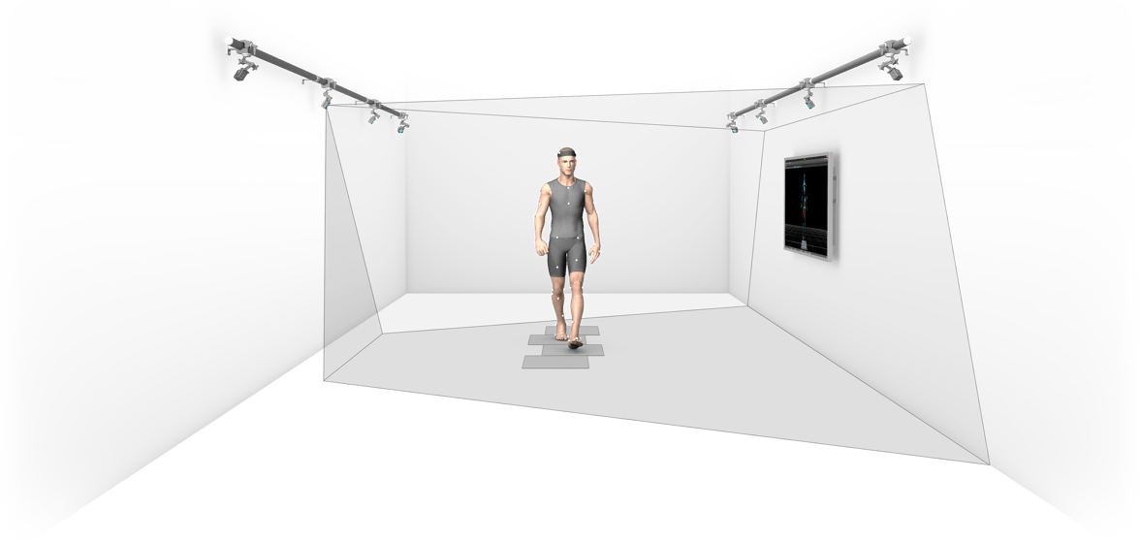
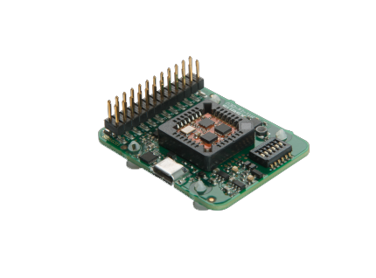
Motivation – Musculoskeletal Analysis
(Clinical) Motion and Gait Analysis
camera
systems
kinematic & kinetic motion parameters:
anatomical kinematics
ground reaction forces
joint reaction forces
muscle forces / activations
optical
markers
force plates
long-term goal:
flexibel & mobile body-worn system
➔ inertial musculoskeletal analysis
typical gait lab equipment

Slide 3

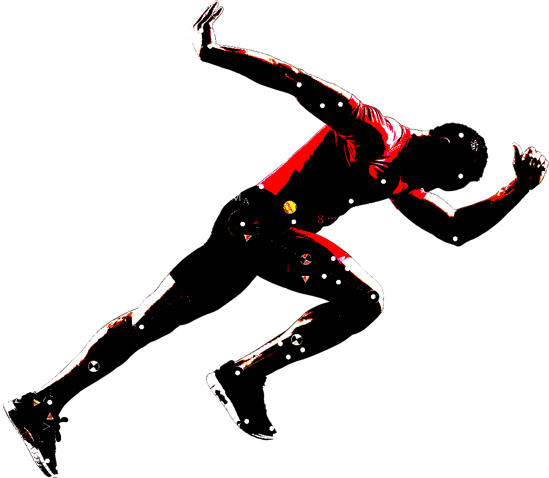

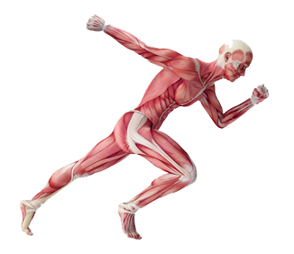
Introduction – Musculoskeletal Analysis Pipeline
motion
sequence
Motion
Capture
motion
trajectories
skeleton model
Inverse
Kinematics
(anatomical)
joint angles
dynamic body
model
Inverse
Dynamics
net joint moments
muscular system
model
Muscle
Recruitment
muscle forces
or activations

Slide 4

Agenda
1. Introduction ➔ 2. Methodology & CONCEPT 3. Results 4. Discussion

Slide 5
Optical vs. Inertial
Musculoskeletal Pipeline
motion
sequence
Motion
Capture
motion
trajectories
skeleton model
Inverse
Kinematics
(anatomical)
joint angles
dynamic body
model
Inverse
Dynamics
net joint moments
muscular system
model
Muscle
Recruitment
muscle forces
or activations
➔ Optical Motion Capture + Inverse Kinematics

Slide 6
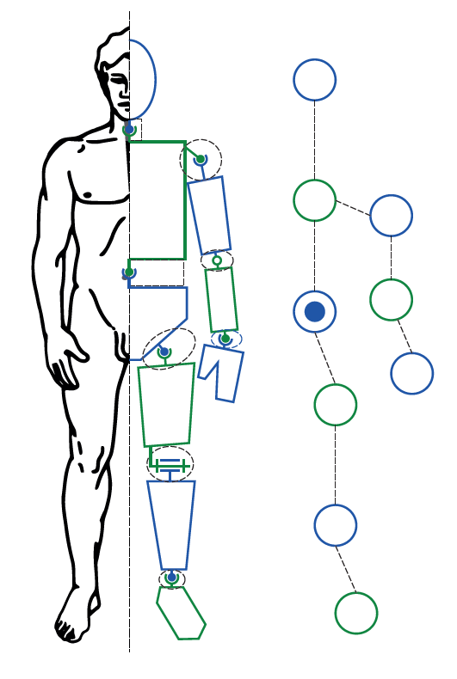
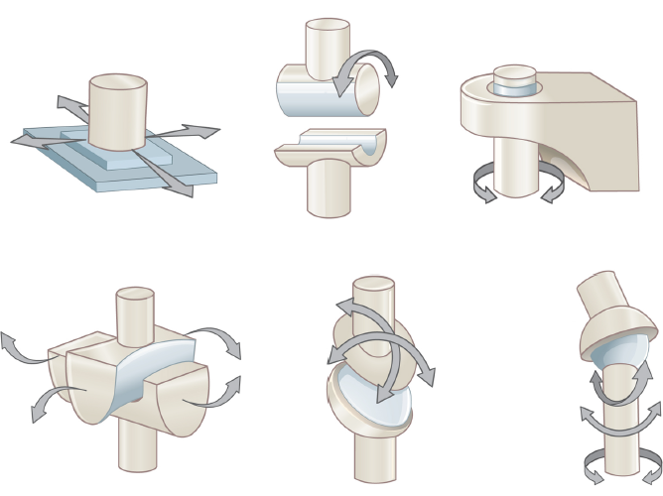
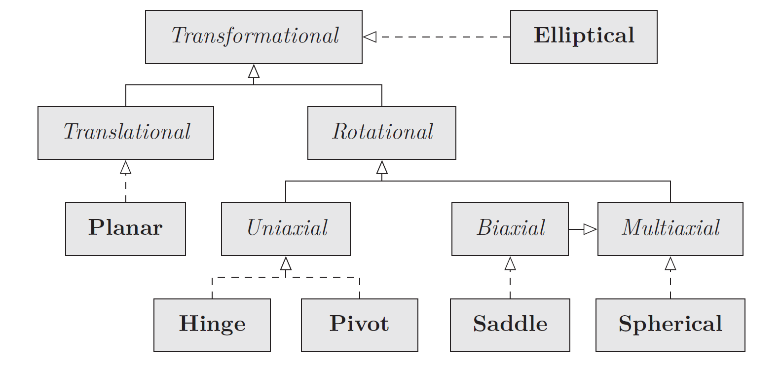

Kinematic Modeling
spherical: no rotational restriction
hinge: one-axis restriction
➔ align frames of incident segments
+ restrict rotation using Euler angles
or:
penalize $r :=a −aR$,
$a$: joint axis, $R\text{:}$ rotation
biaxial: two-axes restriction,
➔ not trivial in general for non-perpendicular axes (cf. thesis)
➔ later
skeleton graph (topology)
of segments and joints
basic synovial joint types
common joint types in practice

Slide 7
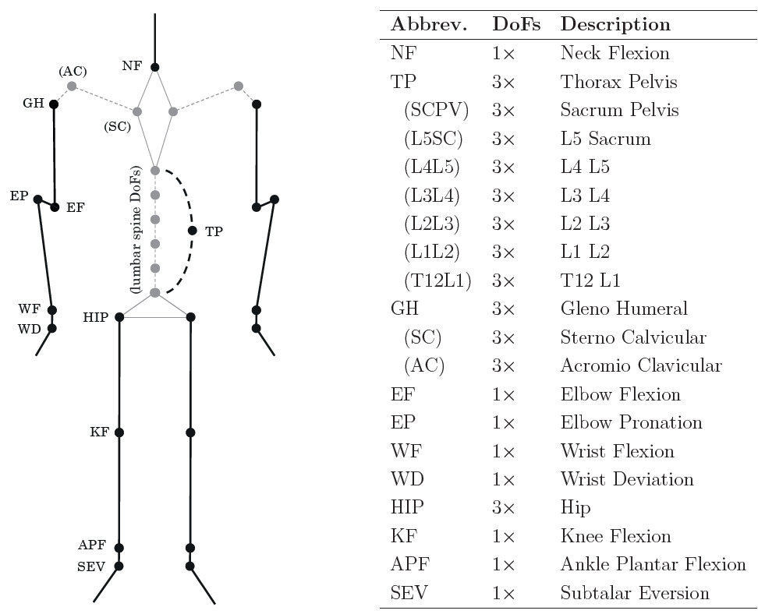
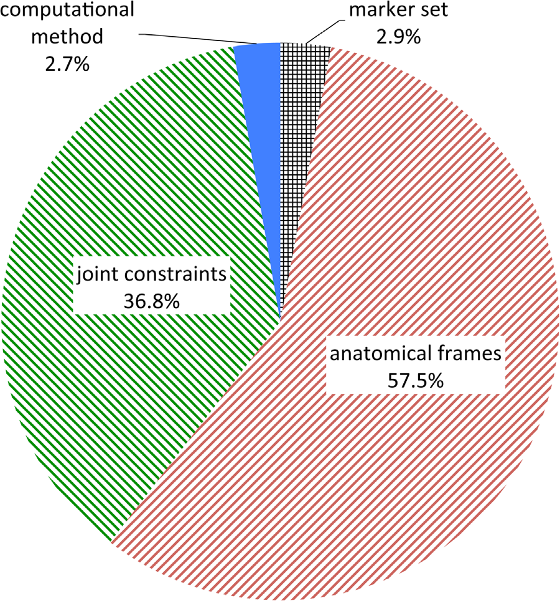
Anatomical Skeletons: AnyBody Full-Body Model
There are various anatomical skeleton models available!
but: kinematics is only comparable among the same underlying model
use the same, detailed, anatomically correct model for all stages of the pipeline
(avoid the propagation of modeling errors through the entire pipeline!)
“Joint kinematic calculation based on clinical direct kinematic versus inverse kinematic gait models.”
Kainz et al. 2016, Journal of Biomechanics
AnyBody skeleton model and DoFs

Slide 8
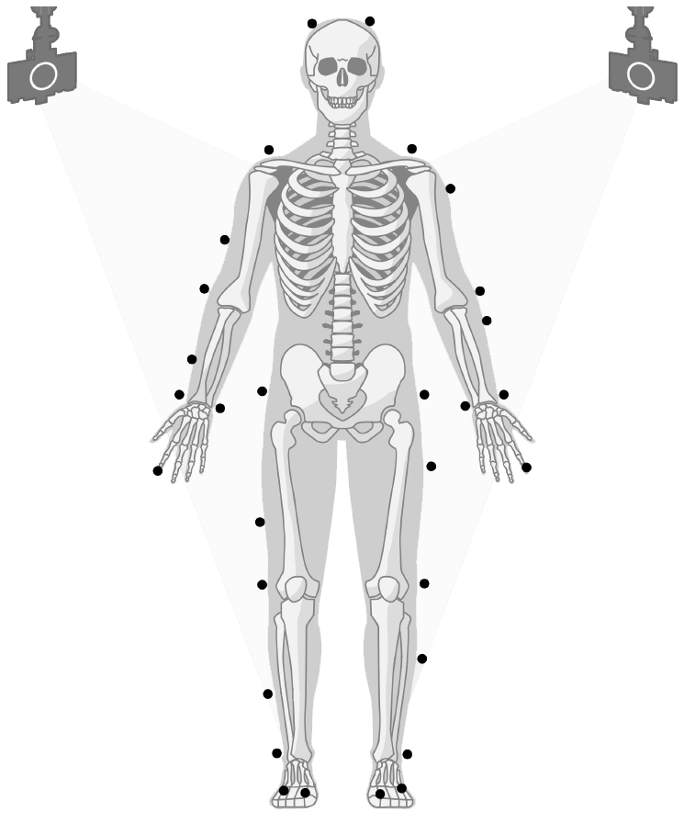
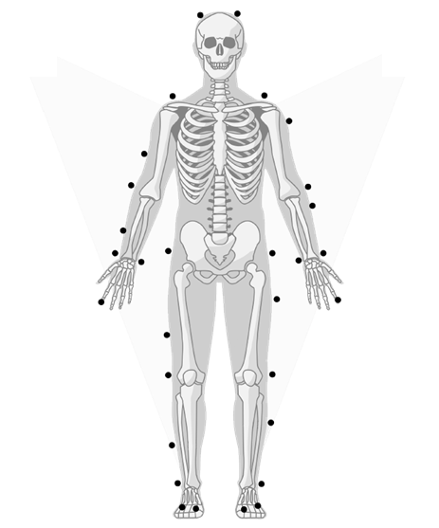
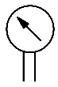
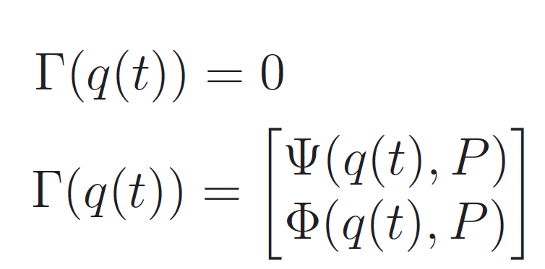
Classical Optical Marker-Based Body Tracking
Model Scaling
kinematic model
anthropometric
measurements
Model Scaling
Motion
Capture
regression
models
scaled kinematic model
(joint-to-joint lengths)
Inverse
Kinematics
Inverse Kinematics
q(t): joint angle trajectories
holonomic system
marker & motion constraints, dep. on model scaling
skeleton joint constraints, dep. on model scaling
➔ precise kinematics ➔ optical marker-based body tracking = “golden standard”

Slide 9
Optical vs. Inertial
Musculoskeletal Pipeline
motion
sequence
Motion
Capture
motion
trajectories
skeleton model
Inverse
Kinematics
(anatomical)
joint angles
dynamic body
model
Inverse
Dynamics
net joint moments
muscular system
model
Muscle
Recruitment
muscle forces
or activations
➔ Inertial Motion Capture + Inverse Kinematics

Slide 10
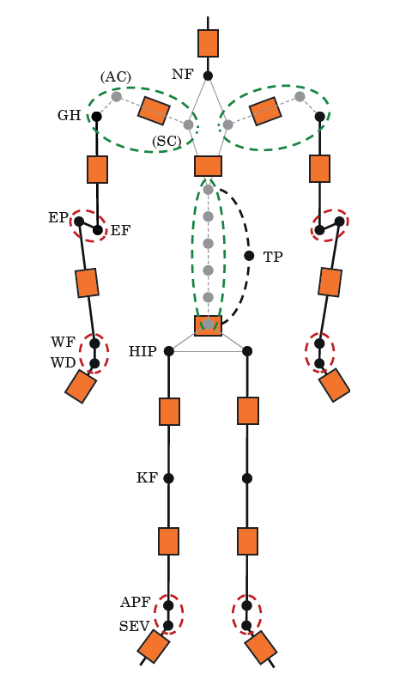
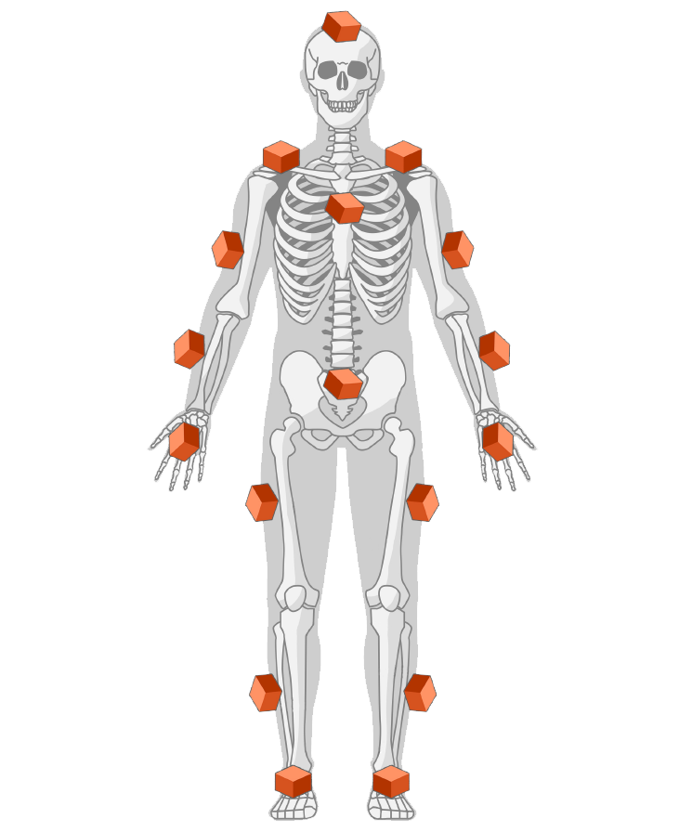
Comparison of Optical vs. Inertial Body Tracking
optical
markers
Inertial Measurement
Units (IMUs)
one-to-one sensor-to-segment mapping is not feasible!
optical: markers at bony landmarks
global body reference frame
marker tracking optimization
marker placement errors
(soft tissue artifacts)
inertial: sensors at segments
local inertial sensor frames
inertial multi-body tracking problem
I2S calibration errors
detailed skeleton model is not directly IMU-trackable

Slide 11
IMU-Trackable Anatomical Skeleton (Shoulder and Spine Rhythms)
AnyBody skeleton implements shoulder and spine kinematics as a functions of only one joint
➔ „shoulder & spine rhythm“ extracted from AnyBody code and implemented
(AC)
GH
(SC)
TP
shoulder rhythm: [AC, SC] = f_{shoulder} (GH)
spine rhythm: [SacrumPelvis, L5Sacrum, L4L5, L3L4, L3L2, L1L2, T12L1] = f_{spine} (TP)
f (.) are linear combinations
green: too many DoFs
compared to IMUs
“Shoulder Rhythm Report” and “Spine Rhythm” Technical Reports, AnyBody Technology A/S

Slide 12

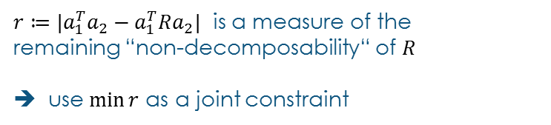
IMU-Trackable Anatomical Skeleton (Arbitrary two-Axes Joint Constraint)
redundant in-between segments ➔ shrink segments to zero length (fuse joints)
simple, if joint axes are perpendicular:
obtain relative orientaton between incident IMUs and decompose it (Euler angles)
➔ is there a rotation decomposition about „arbitrary axes“?
shank
two-axes decomposition:
with $R$ and two non-collinear axes $a_{1}$ and $a_{2}$,
$R$ is decomposable about $a_{1},a_{2}$ iff:
$a_{1}^{T}a_{2}=a_{1}^{T}Ra_{2}$
APF
~60 °
fused joint
SEV
${r≔|a}_{1}^{T}a_{2}−a_{1}^{T}Ra_{2}|$ is a measure of the
remaining “non-decomposability“ of $R$
➔ use$\min{r}$ as a joint constraint
foot
example: ankle joint
∠(APF, SEV) ~= 60 °
red: DoFs trackable in principle, but redundant in-between segment
“On Coordinate-Free Rotation Decomposition: Euler Angles about Arbitrary Axes.” Piovan, Bullo 2012

Slide 13
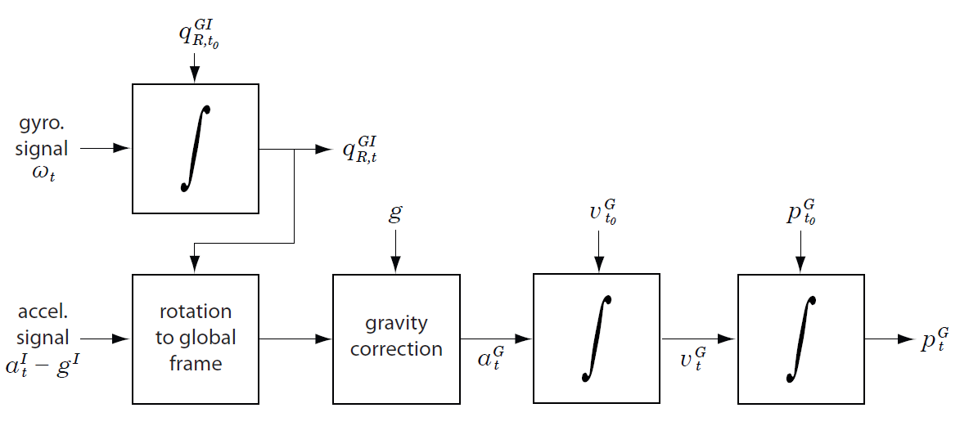
Inertial Inverse Kinematics
Complementary Inertial Sensor Fusion / Strapdown Integration:
accelerometer + gyroscope ( + magnetometer )
Motion
Capture
Inverse
Kinematics
Multi Sensor Fusion: Extended Kalman Filter (EKF)
Coupled Fusion Approach: QuatTracker
EKF
tackable skeleton model
( + two-axes joint constraints
+ shoulder & spine rhythm )
QuatTracker
Strapdown
“On inertial body tracking in the presence of model calibration errors”, Miezal, Taetz, Bleser, Sensors, vol. 16, no. 7, p. 1132, 2016

Slide 14
Optical vs. Inertial
Musculoskeletal Pipeline
motion
sequence
Motion
Capture
motion
trajectories
skeleton model
Inverse
Kinematics
(anatomical)
joint angles
dynamic body
model
Inverse
Dynamics
net joint moments
muscular system
model
Muscle
Recruitment
muscle forces
or activations
➔ Inverse Dynamics + Static Optimization

Slide 15
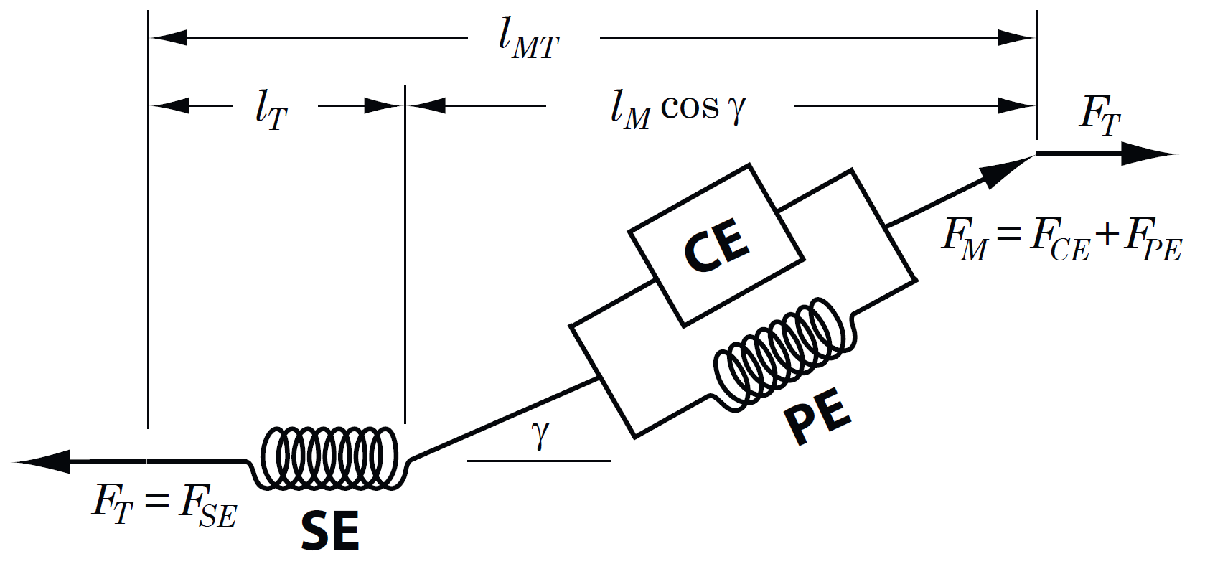
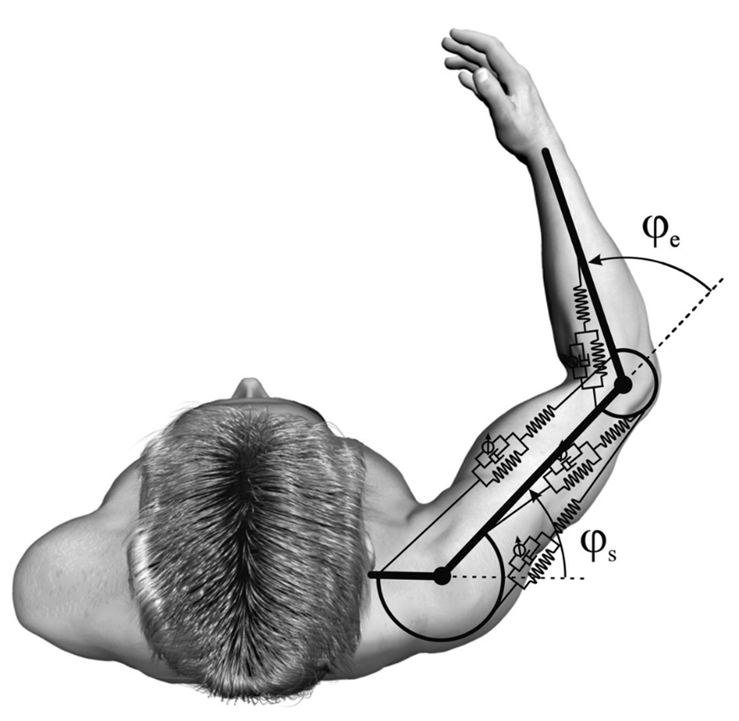
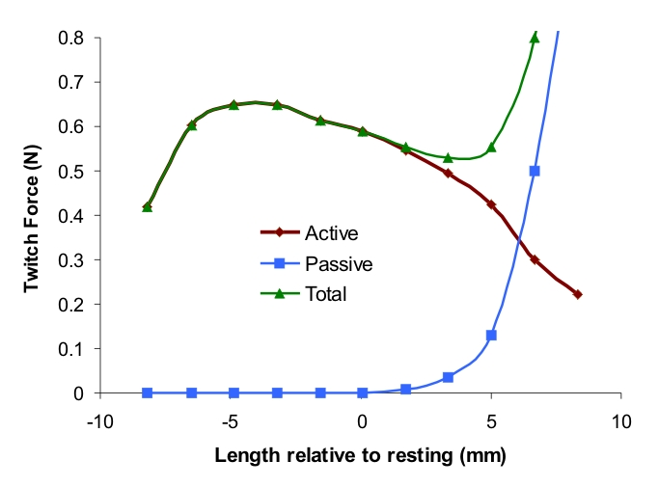
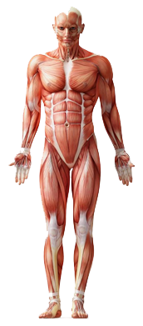
Dynamic Modeling
scaled kinematic model
body mass
distributions
Model Scaling
body fat per-
centage (BMI)
scaled dynamic model
dynamic body model
(masses and inertia)
+
muscular system model
(muscle geometry)
basic hill type muscle model (musculotendon unit )

Slide 16
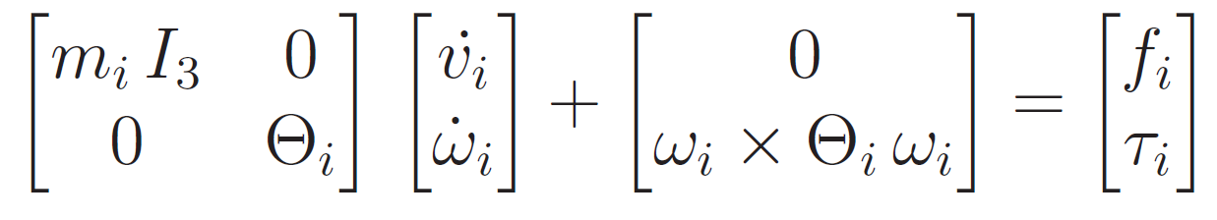
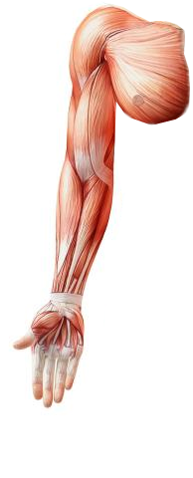
Inverse Dynamics
Equations of Motion
net forces
and torques
➔ muscle forces?
M
M
F
F
mapping?
Muscular Redundancy Problem
- “How to distribute net joint moments over all involved muscles?”
shoulder pitch
shoulder roll
example: arm without hand
7 DoFs
but > 20 skeletal muscles
shoulder yaw
Inverse
Dynamics
elbow pitch
elbow roll
wrist yaw
wrist pitch
joints are over-actuated ⬄ muscle system is underdetermined
➔ muscle recruitment solution requires additional constraints
Muscle
Recruitment

Slide 17
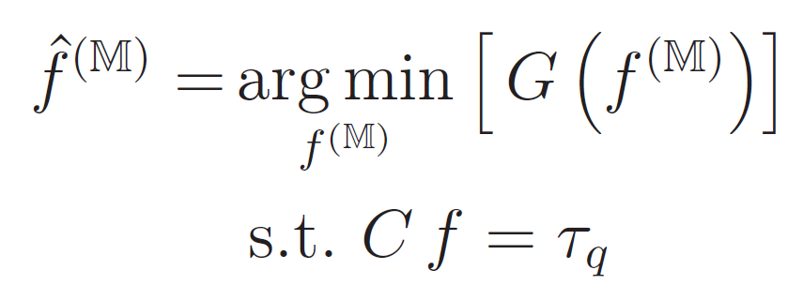
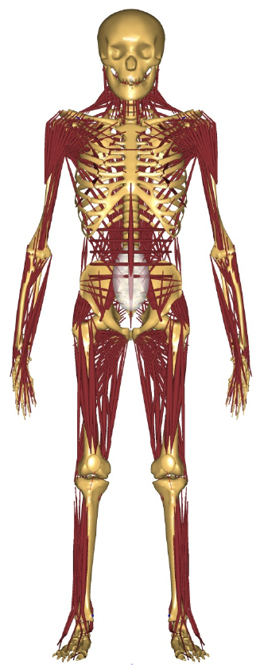
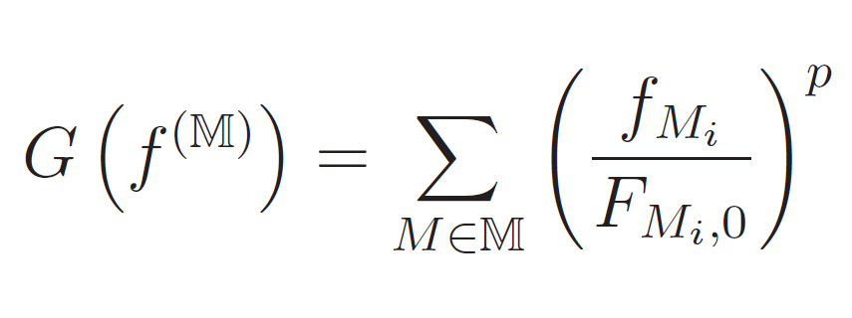
Muscle Recruitment Optimization
Idea of Static Optimization
in each time step, choose a solution that minimizes the total muscle stress
while fulfilling the force balance prescribed by the equations of motion:
Muscle Recruitment Criterion
cf. polynomial norms
Inverse
Dynamics
p = 1: linear recruitment: allocate more work to stronger muscles
➔ minimum number of muscles for equilibrium
p = 2: quadratic recruitment: penalize large single force terms
➔ emphasize load sharing, i.e. muscle synergy effects
Muscle
Recruitment
p = ∞: min-max recruitment: balance loads among muscles as best as possible
➔ minimum muscle fatigue or maximum synergism criterion

Slide 18
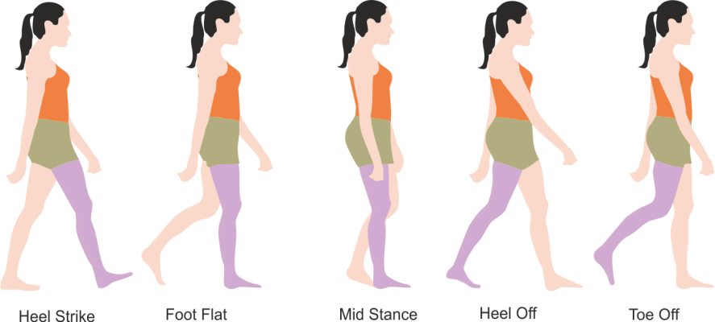
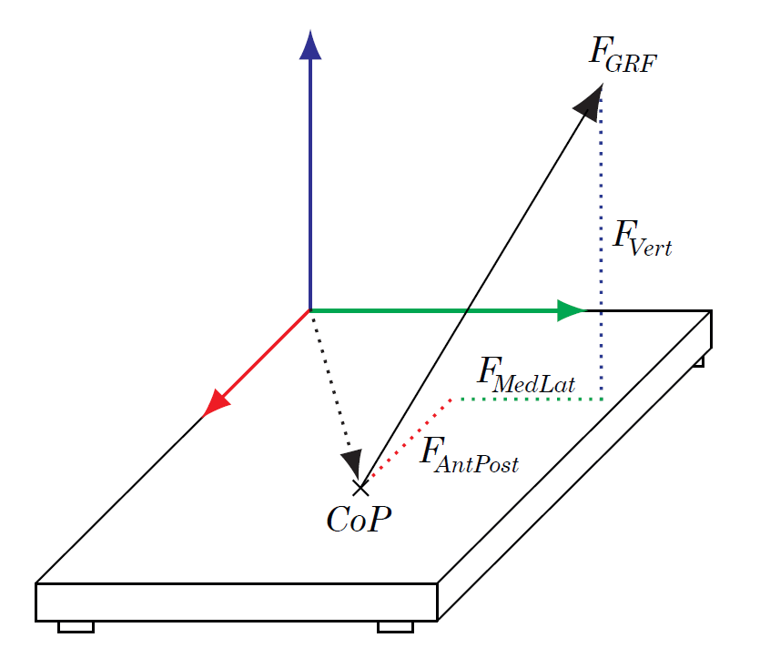
Ground Reaction Forces
Why and how to measure GRFs?
➔ GRFs indetermined during double feet contact phases (closed kinematic chain)
Limitations of GRF Measurements
possible dynamic inconsistency of equations of motions for measured GRFs
inconvenient and inflexible force plate devices
GRF prediction using additional assumptions / constraints ... ?
optimization based approach [Audu et al. 2003]
smooth transitions functions, interpolated from empirical measurements [Ren et al. 2008]
artificial neural networks [Choi et al. 2013]
zero-moment point (robotics)
or ... ?
Inverse
Dynamics
Static
Optimization

Slide 19
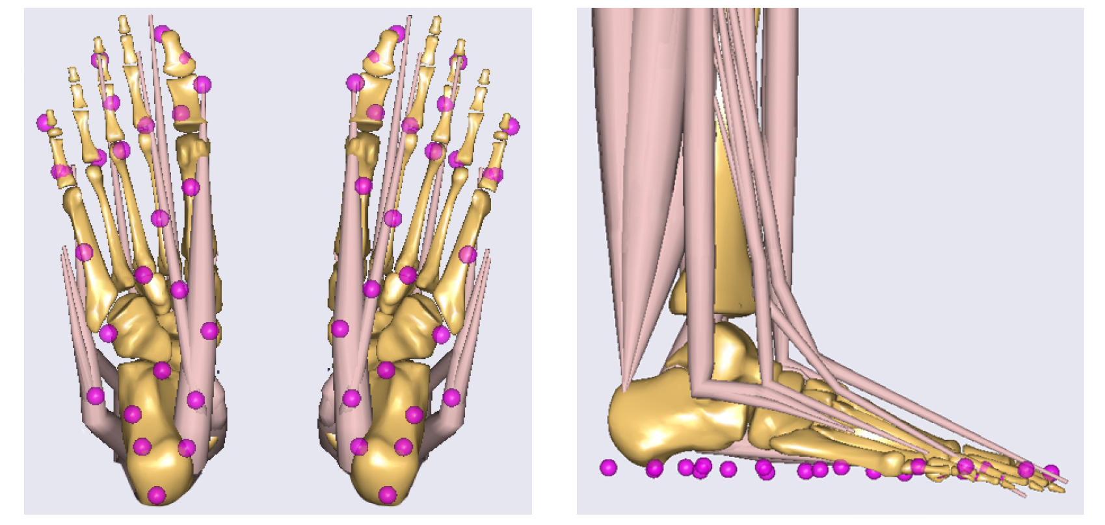
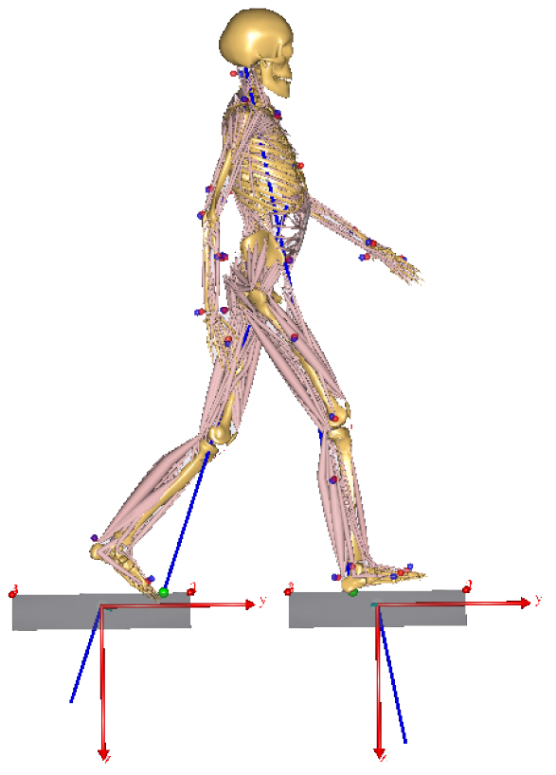
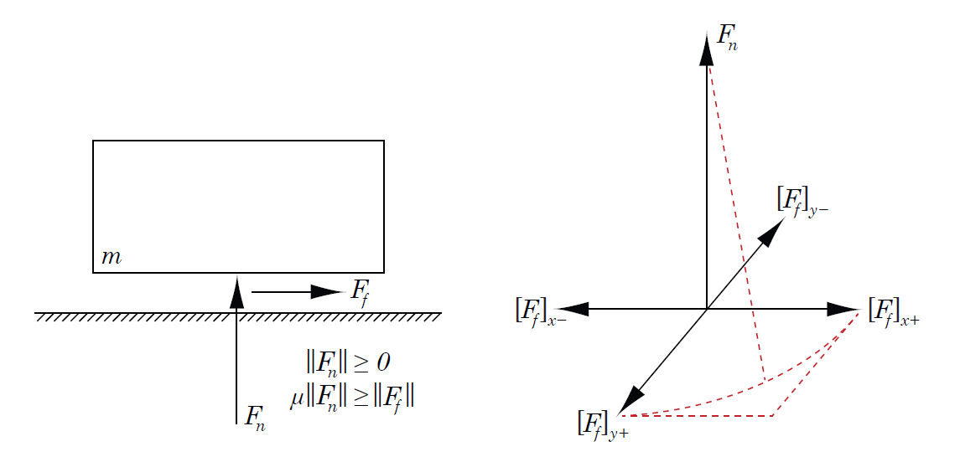
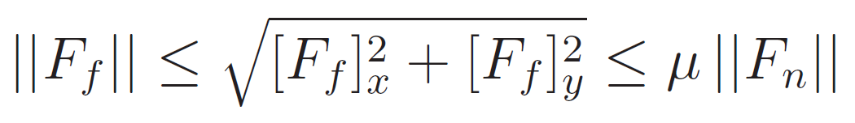
Ground Reaction Force Prediction
Idea: Artificial Muscle-Like Actuators at Foot Ground Contact Points
25 ground contact points per foot
5 muscle-like actuators per point
ground contact conditions for each point:
zero-velocity condition
height threshold
➔ integration into Static Optimization
Inverse
Dynamics
Static
Optimization
“Prediction of ground reaction forces and moments during various activities of daily living.” Fluit et al. 2014, Journal of Biomechanics

Slide 20
Agenda
1. Introduction 2. Methodology & CONCEPT ➔ 3. Results 4. Discussion

Slide 21
Optical vs. Inertial
Musculoskeletal Pipeline
motion
sequence
Motion
Capture
motion
trajectories
skeleton model
Inverse
Kinematics
(anatomical)
joint angles
dynamic body
model
Inverse
Dynamics
net joint moments
predicted
GRFS
muscular system
model
Static
Optimization
muscle forces
or activations
➔ GRF Prediction: Validation & Sensitivity Analysis

Slide 22
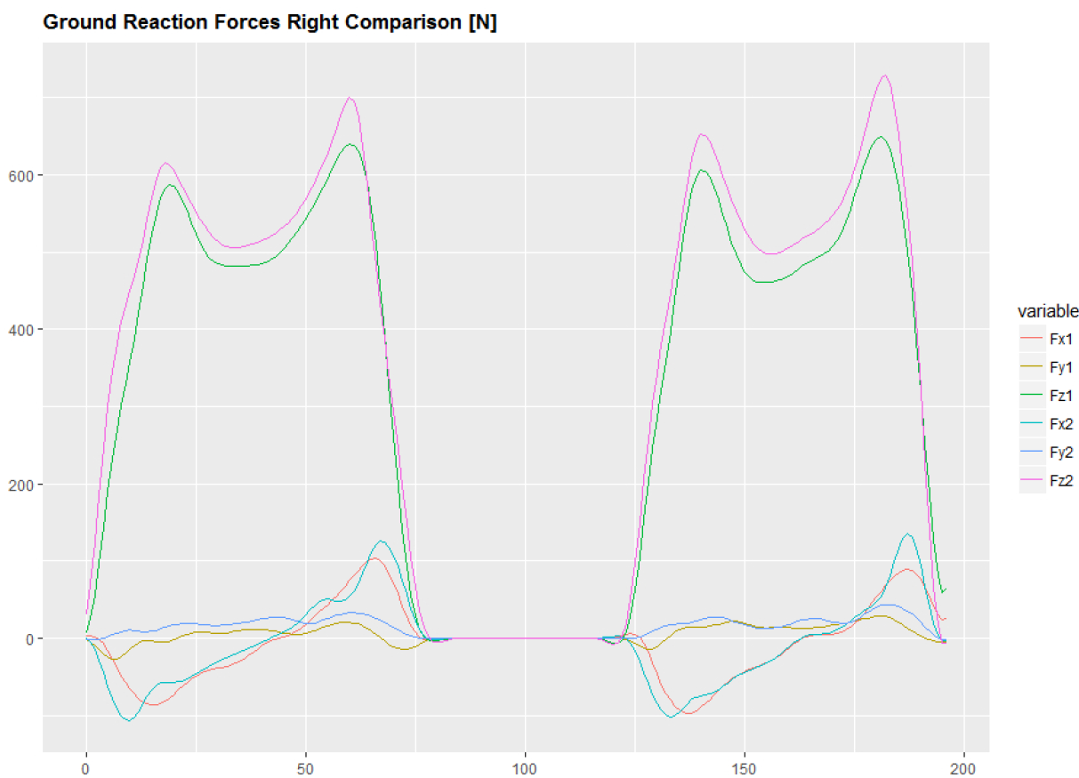
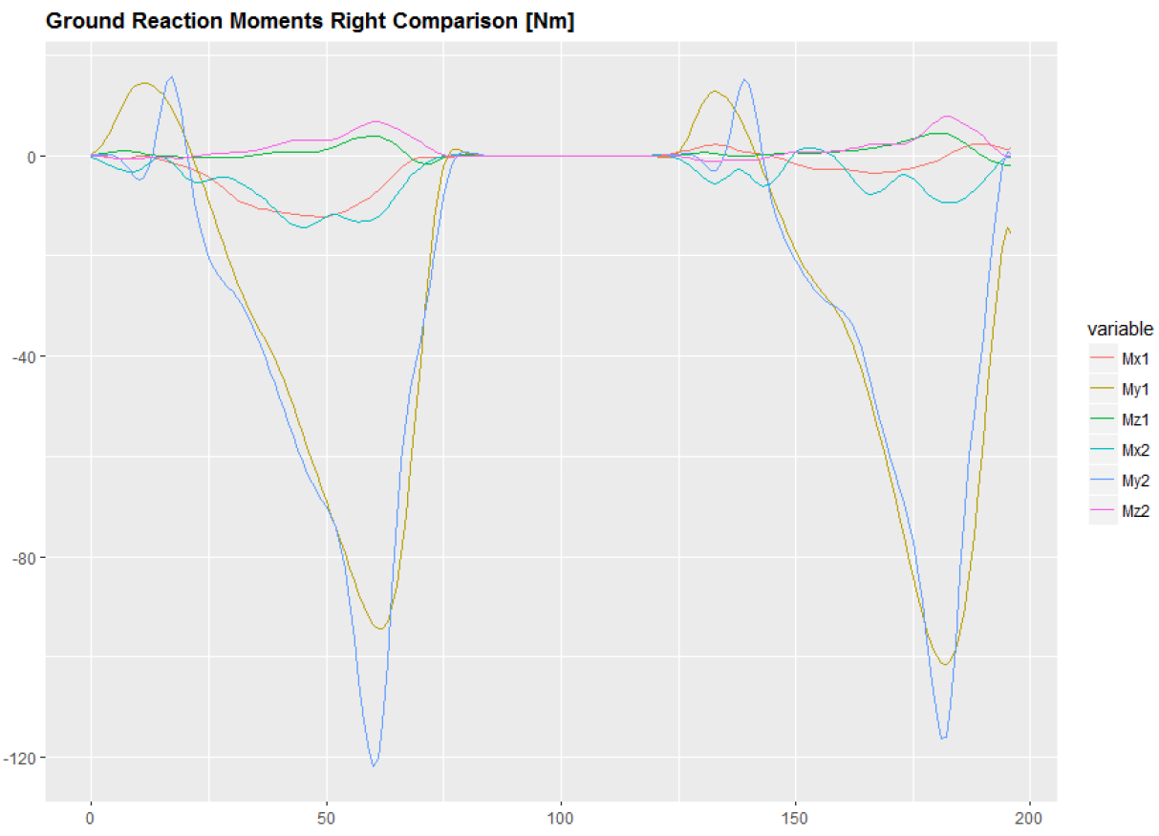
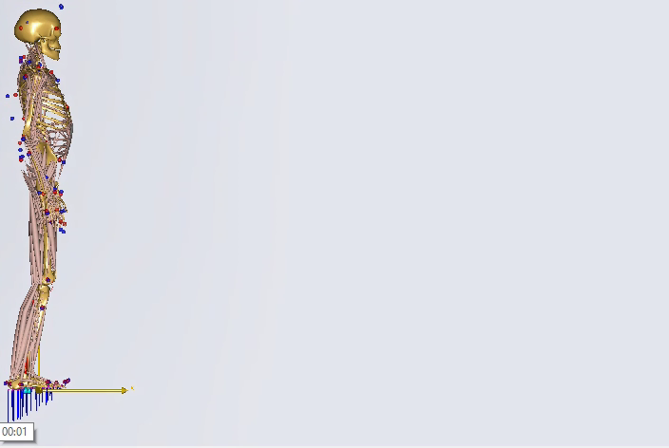
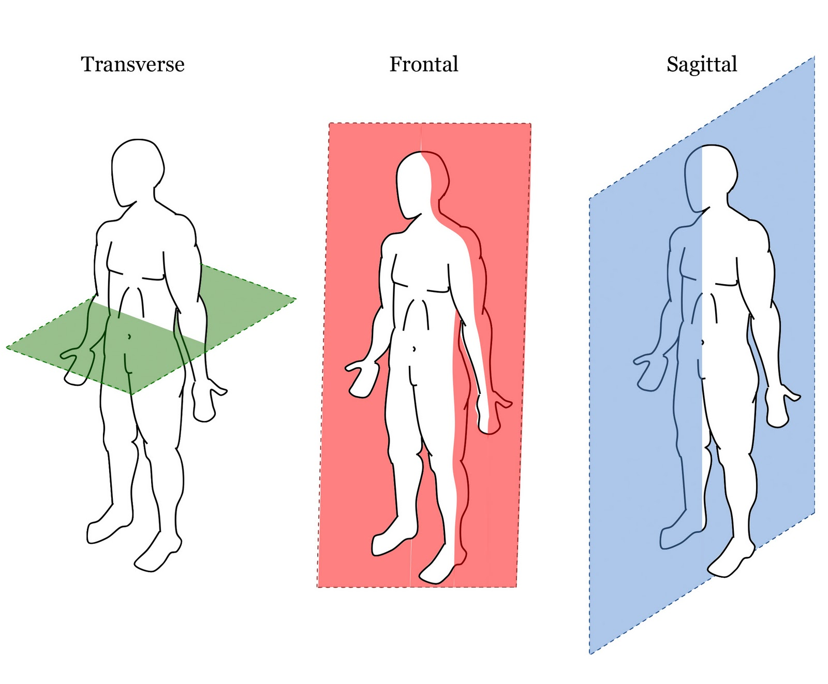
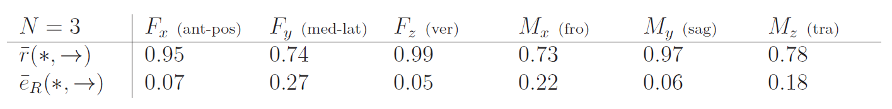
GRF Prediction Validation
1
2
3
4
5
gait cycle with gait events
1
2
3
4
5
z
➔ results in accordance with [Fluit et al. 2014] and [Skals 2016]
x
y

Slide 23
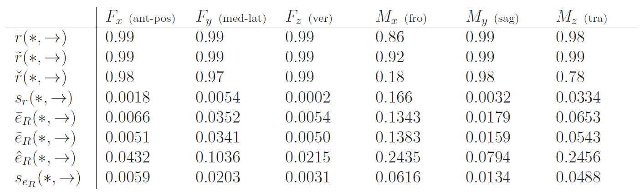
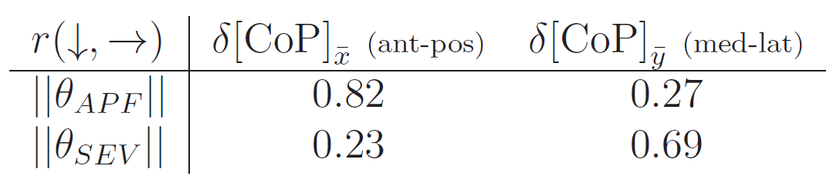
GRF Prediction Sensitivity Analysis (Ground Contact Conditions)
Ankle Plantar Flexion (APF)
Subtalar Eversion (SEV)
error sampling range of [±12 ° x ±12 °]
APF + SEV ➔ foot posture during touchdown
tradeoff between prediction robustness
and CoP precision
➔ GRF prediction is robust against foot posture disturbances

Slide 24
Optical vs. Inertial
Musculoskeletal Pipeline
motion
sequence
Motion
Capture
motion
trajectories
skeleton model
Inverse
Kinematics
(anatomical)
joint angles
dynamic body
model
Inverse
Dynamics
net joint moments
predicted
GRFS
muscular system
model
Static
Optimization
muscle forces
or activations
➔ I2S Calibration Error Simulation

Slide 25
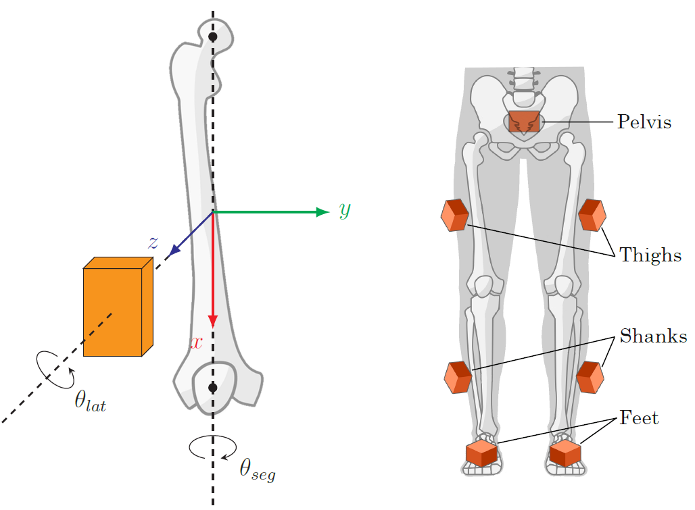
I2S Calibration Error Simulation
Effects of simulated I2S calibration errors on predicted GRFs
➔ how accurate are biomechanical analysis results w.r.t. I2S errors?
➔ what calibration precision is required?
IMU
IMU
segment
segment
simulated errors around lateral and segmental axes

Slide 26
I2S Calibration Errors: Effects on Predicted GRFs per Segment
correlations of disturbed vs. true predicted GRFs for anterior initial calibration, error sampling range of [±12 ° x ±12 °]
anterior initial calibration
Pelvis
Thigh
Shank
Foot
lateral initial calibration
correlations of disturbed vs. true predicted GRFs for lateral initial calibration, error sampling range of [±12 ° x ±12 °]

Slide 27
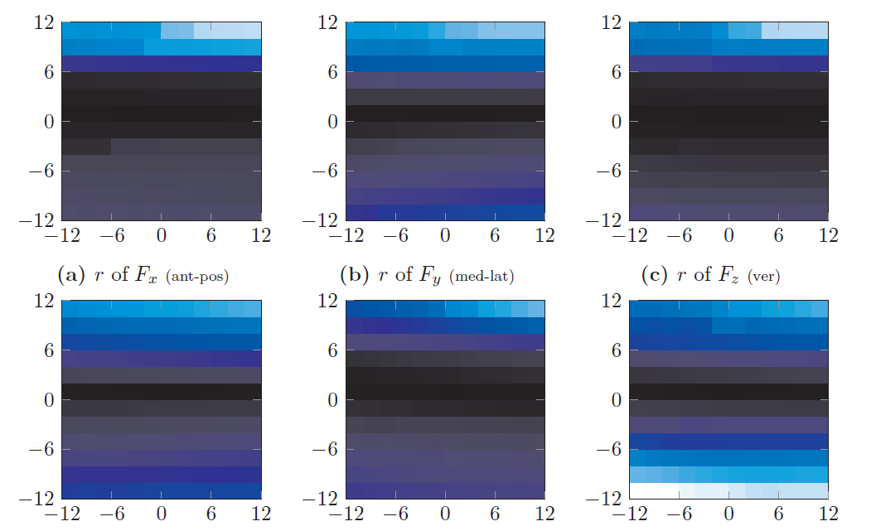
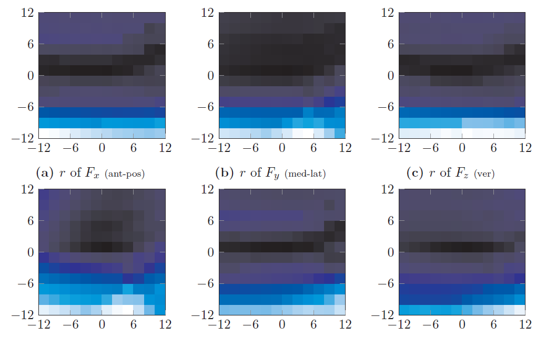
I2S Calibration Errors: Effects on Predicted GRFs per Segment
qualitattive correlation distributions for lateral initial calibration, error sampling range of [±12 ° x ±12 °]
Fx (ant-pos)
Fy (med-lat)
Fz (ver)
Fx (ant-pos)
Fy (med-lat)
Fz (ver)
lat
Mx (fro)
My (sag)
Mz (tra)
lat
Mx (fro)
My (sag)
Mz (tra)
seg
Shank
seg
Foot

Slide 28
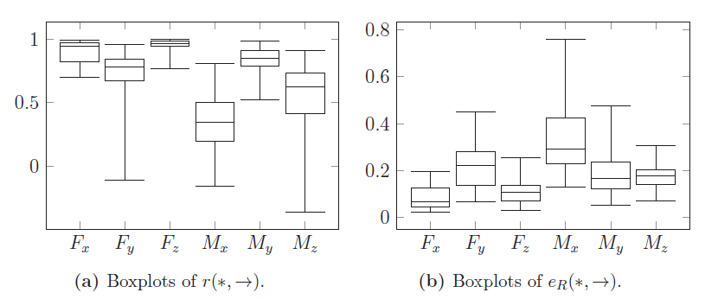
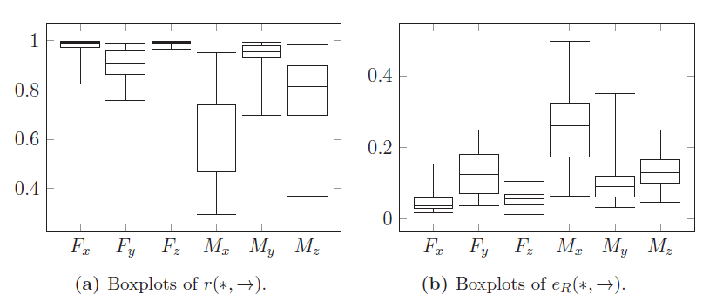
I2S Calibration Errors: Effects on Predicted GRFs in Typical Scenario
monte carlo simulation of I2S errors for all lower body segments in an error range of [±12 ° x ±12 °]
monte carlo simulation of I2S errors for all lower body segments in a reduced range of [±6 ° x ±6 °]

Slide 29
Agenda
1. Introduction 2. Methodology & CONCEPT 3. Results ➔ 4. Discussion

Slide 30
Conclusion
musculoskeletal analysis pipeline for both optical and inertial body tracking
anatomical IMU-trackable skeleton, consistently used in the entire pipeline
➔ avoid (unknown) modeling errors
integration of a universal GRF prediction approach
➔ “universal” = no training / empirical data required, only kinematics
sensitivity of GRF Prediction (ground contact conditions)
➔ very robust for moderate foot posture disturbances
systematic I2S calibration error simulation
➔ robustness dependent on initial IMU configuration per segment
➔ generally: much higher impact of errors on lateral axis
➔ acceptable GRF prediction errors for proper initial configuration
typical I2S error scenario for all lower body segments
➔ errors at segments accumulate → moderate to high GRF prediction deviations
➔ acceptable errors for reduced error range of [±6 ° x ±6 °]

Slide 31
Future Work
quantitatively proof the advantages of using the same model for the entire pipeline
➔ compare with kinematics + dynamics obtained with different models
repeat studies with real data
➔ use real inertial reference trajectories
use force plate measurements
what about pathological gaits / motion sequences?
➔ GRF prediction valid?
lower body ➔ full-body I2S error simulation
(investigate muscle activation estimations in more detail)
(can we make the inverse dynamics computationally more efficient?)
(integrate and compare different biomechanical frameworks and models, e.g. OpenSim vs. AnyBody)

Slide 32
Questions?
Thank you for your attention!

Slide 33
#include <everything>
Optical vs. Inertial
Musculoskeletal Pipeline
motion
sequence
Motion
Capture
motion
trajectories
skeleton model
Inverse
Kinematics
(anatomical)
joint angles
dynamic body
model
Inverse
Dynamics
net joint moments
predicted
GRFs
muscular system
model
Muscle
Recruitment
muscle forces
or activations
➔ Overall System Design & Implementation

Slide 34
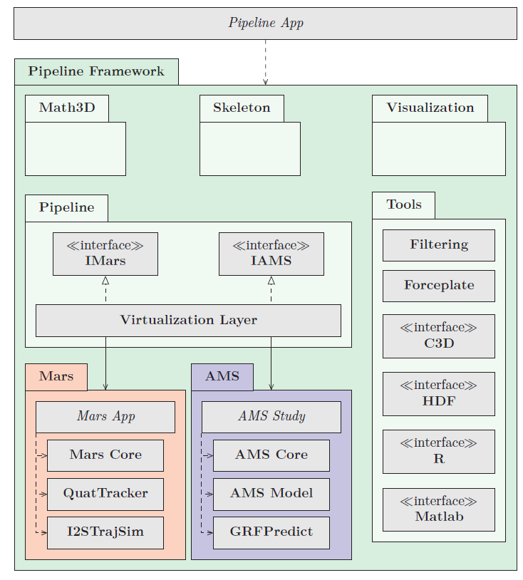
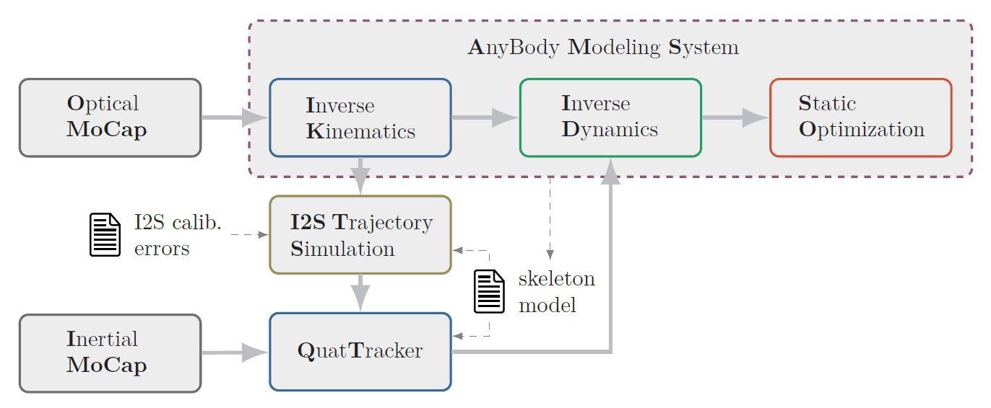
Overall Design & Implementation
I2S Trajectory Simulation
data differentiation
realistic inertial sensor error + noise model

Slide 35
Shoulder Rhythm Implementation
public static Dictionary<string, EulerAngles> ShoulderRhythmDOFs(EulerAngles glenohumeralLeftDOFs, EulerAngles glenohumeralRightDOFs)
{
glenohumeralLeftDOFs = glenohumeralLeftDOFs.ToEulerAngles("XZY");
glenohumeralRightDOFs = glenohumeralRightDOFs.ToEulerAngles("XZY");
// Functions from shoulder rhythm definition in file /Body/AAUHuman/Arm/JntSR.any
var sternoClavicularLeftDOFs = new EulerAngles(
0.422 * glenohumeralLeftDOFs.X - 0.423,
-0.242 * glenohumeralLeftDOFs.X + 0.12 * glenohumeralLeftDOFs.Z + 0.851 * -0.401 - 4.983.ToRad() + 10d.ToRad(),
0.123 * glenohumeralLeftDOFs.X - 0.046 * glenohumeralLeftDOFs.Z + 0.493 * 0.201 + 3.917.ToRad() - 6d.ToRad()
, "YZX");
var sternoClavicularRightDOFs = new EulerAngles(
0.422 * glenohumeralRightDOFs.X - 0.423,
-0.242 * glenohumeralRightDOFs.X + 0.12 * glenohumeralRightDOFs.Z + 0.851 * -0.401 - 4.983.ToRad() + 10d.ToRad(),
0.123 * glenohumeralRightDOFs.X - 0.046 * glenohumeralRightDOFs.Z + 0.493 * 0.201 + 3.917.ToRad() - 6d.ToRad()
, "YZX");
var sign = +1d;
var scapulaThoraxLeftDOFs = new EulerAngles(
0d,
-0.049 * sign * glenohumeralLeftDOFs.X + 0.14 * sign * glenohumeralLeftDOFs.Z + sign * -1.203.ToRad() + 0.901 * 0.33 + 10d.ToRad(),
0.396 * sign * glenohumeralLeftDOFs.X - 0.079 * sign * glenohumeralLeftDOFs.Z + sign * 3.095.ToRad() + 0.414 * 0.307 - 10d.ToRad()
, "YZX");
sign = -1d;
var scapulaThoraxRightDOFs = new EulerAngles(
0d,
-0.049 * sign * glenohumeralLeftDOFs.X + 0.14 * sign * glenohumeralLeftDOFs.Z + sign * -1.203.ToRad() + 0.901 * 0.33 + 10d.ToRad(),
0.396 * sign * glenohumeralLeftDOFs.X - 0.079 * sign * glenohumeralLeftDOFs.Z + sign * 3.095.ToRad() + 0.414 * 0.307 - 10d.ToRad()
, "YZX");
return new Dictionary<string, EulerAngles>()
{
{ "SternoClavicularLeft", sternoClavicularLeftDOFs },
{ "SternoClavicularRight", sternoClavicularRightDOFs },
{ "ScapulaThoraxLeft", scapulaThoraxLeftDOFs },
{ "ScapulaThoraxRight", scapulaThoraxRightDOFs }
};
}

Slide 36
Spine Rhythm Implementation
public static Dictionary<string, EulerAngles> SpineRhythmDOFs(EulerAngles pelvisThoraxDOFs)
{
pelvisThoraxDOFs = pelvisThoraxDOFs.ToEulerAngles("ZYX");
var t12L1WeightMatrix = Matrix<double>.Build.DenseOfArray(new[,]
{
// Matrix from spine rhythm definition in file /Body/AAUHuman/Trunk/SRMatrixes.any
{ 7.105616e-002, 2.276759e-001, 4.020500e-001, 5.784718e-001, 7.462112e-001, 9.131695e-001, 1.00000000000 }, // X factors
{ 0.00000000000, 1.421123e-001, 3.132395e-001, 4.908604e-001, 6.660833e-001, 8.263391e-001, 1.00000000000 }, // Y factors
{ 7.105616e-002, 2.276759e-001, 4.020500e-001, 5.784718e-001, 7.462112e-001, 9.131695e-001, 1.00000000000 } // Z factors
});
var t12L1DOFs = new EulerAngles(pelvisThoraxDOFs.X / t12L1WeightMatrix.Row(0).Sum(), pelvisThoraxDOFs.Y / t12L1WeightMatrix.Row(1).Sum(), pelvisThoraxDOFs.Z / t12L1WeightMatrix.Row(2).Sum());
return new Dictionary<string, EulerAngles>()
{
{ "SacrumPelvis" , new EulerAngles(t12L1DOFs.X * t12L1WeightMatrix[0, 0], t12L1DOFs.Y * t12L1WeightMatrix[1, 0], t12L1DOFs.Z * t12L1WeightMatrix[2, 0]) },
{ "L5Sacrum" , new EulerAngles(t12L1DOFs.X * t12L1WeightMatrix[0, 1], t12L1DOFs.Y * t12L1WeightMatrix[1, 1], t12L1DOFs.Z * t12L1WeightMatrix[2, 1]) },
{ "L4L5" , new EulerAngles(t12L1DOFs.X * t12L1WeightMatrix[0, 2], t12L1DOFs.Y * t12L1WeightMatrix[1, 2], t12L1DOFs.Z * t12L1WeightMatrix[2, 2]) },
{ "L3L4" , new EulerAngles(t12L1DOFs.X * t12L1WeightMatrix[0, 3], t12L1DOFs.Y * t12L1WeightMatrix[1, 3], t12L1DOFs.Z * t12L1WeightMatrix[2, 3]) },
{ "L2L3" , new EulerAngles(t12L1DOFs.X * t12L1WeightMatrix[0, 4], t12L1DOFs.Y * t12L1WeightMatrix[1, 4], t12L1DOFs.Z * t12L1WeightMatrix[2, 4]) },
{ "L1L2" , new EulerAngles(t12L1DOFs.X * t12L1WeightMatrix[0, 5], t12L1DOFs.Y * t12L1WeightMatrix[1, 5], t12L1DOFs.Z * t12L1WeightMatrix[2, 5]) },
{ "T12L1" , t12L1DOFs }
};
}

